Slide 1
Reminders
Homework 12 / Milestone 4 are due Due Wednesday.
Sign-up for a 30-minute slot to present your final Project at
ccb.youcanbook.me

Slide 2
What have we learned?
Final Lecture of CIS 530
Notes:
Stanford Question Answering Dataset (SQuAD) consists of passages from Wikipedia and associated questions whose answers are spans from the passage, for just over150,000 questions.

Slide 3
Text Classification

Slide 4
Regular Expressions
and Hearst Patterns
The bow lute, such as the Bambara ndang, is plucked and has an individual curved neck for each string
Notes:
https://xkcd.com/208/

Slide 5
Morphology
Morphemes:
The small meaningful units that make up words
Stems: The core meaning-bearing units
Affixes: Bits and pieces that adhere to stems
Often with grammatical functions

Slide 6
Stemming
Reduce terms to their stems in information retrieval
Stemming is crude chopping of affixes
language dependent
e.g., automate(s), automatic, automation all reduced to automat.
for example compressed
and compression are both
accepted as equivalent to
compress.
for exampl compress and
compress ar both accept
as equival to compress
Notes:
Stemming refers to a simpler version of lemmatization in which we mainly just strip suffixes from the end of the word.

Slide 7
Word Pieces via Byte Pair Encoding

Slide 8
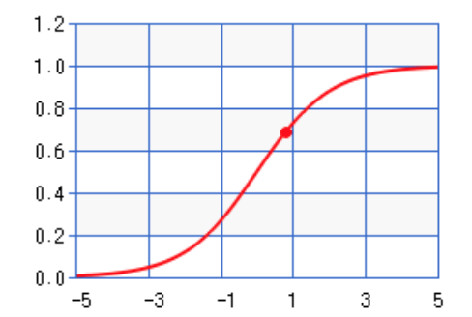
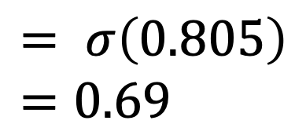
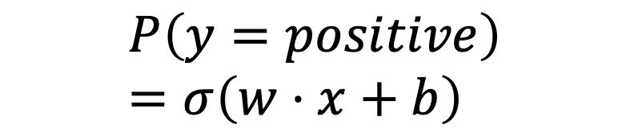
Logistic Regression
Var | Definition | Value | Weight | Product
x₁ | Count of positive lexicon words | 3 | 2.5 | 7.5
x₂ | Count of negative lexicon words | 2 | -5.0 | -10
x₃ | Does no appear? (binary feature) | 1 | -1.2 | -1.2
x₄ | Num 1st and 2nd person pronouns | 3 | 0.5 | 1.5
x₅ | Does ! appear? (binary feature) | 0 | 2.0 | 0
x₆ | Log of the word count for the doc | 4.15 | 0.7 | 2.905
b | bias | 1 | 0.1 | .1
$$P\left(y=positive\right)=σ\left(w⋅x+b\right)$$
$$= σ\left(0.805\right)=0.69$$
Notes:
So the probability that this is a positive review = 69%. The probability that it’s a negative review is 31%

Slide 9
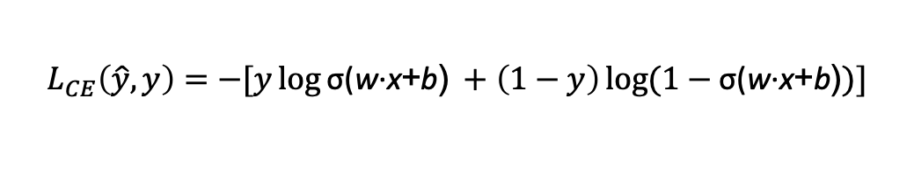
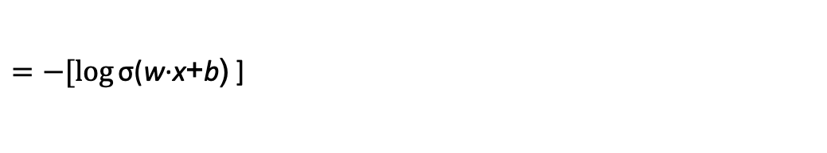
Cross-entropy loss
Why does minimizing this negative log probability do what we want? We want the loss to be smaller if the model’s estimate is close to correct, and we want the loss to be bigger if it is confused.
It's hokey. There are virtually no surprises , and the writing is second-rate . So why was it so enjoyable? For one thing , the cast is great . Another nice touch is the music . I was overcome with the urge to get off the couch and start dancing . It sucked me in , and it'll do the same to you .
P(sentiment=1|It’s hokey...) = 0.69. Let’s say y=1.
$$L_{CE}\left(\hat{y}, y\right)=−[y\log{\text{σ}\text{(}\text{w}\text{·}\text{x}\text{+}\text{b}\text{)} }+\left(1−y\right)\log{(1−\text{σ}\text{(}\text{w}\text{·}\text{x}\text{+}\text{b}\text{)})]}$$
$=−[\log{\text{σ}\text{(}\text{w}\text{·}\text{x}\text{+}\text{b}\text{)} }$]
$$=−\log{\text{(}\text{0.69}\text{)}=0.37}$$
Notes:
This loss function also ensures that as probability of the correct answer is maximized, the probability of the incorrect answer is minimized; since the two sum to one, any increase in the probability of the correct answer is coming at the expense of the incorrect answer.

Slide 10
Gradient Descent
Notes:
The intuition is that if you are skiing in a canyon and trying to descend most quickly down to the river at the bottom, you might look around yourself 360 degrees, find the direction where the ground is sloping the steepest, and godownhill in that direction.

Slide 11
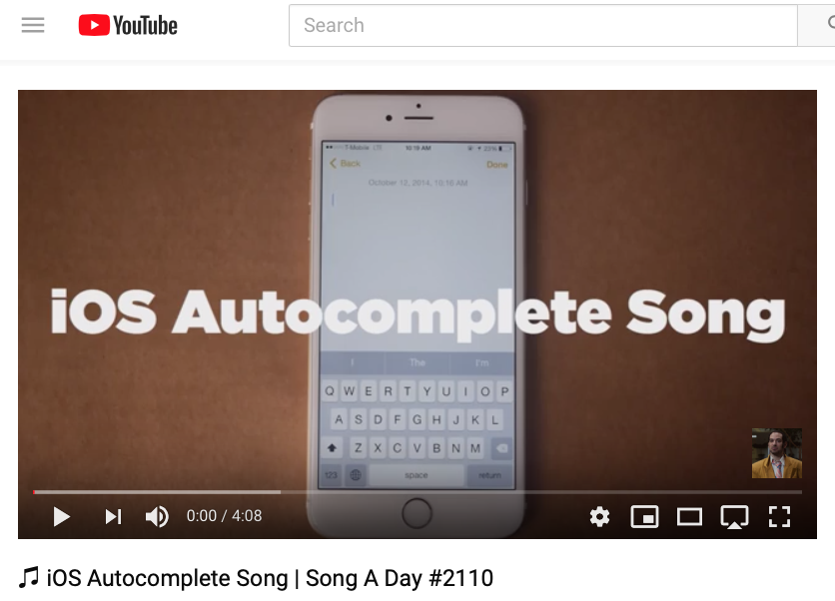
https://www.youtube.com/watch?v=M8MJFrdfGe0
Notes:
https://www.youtube.com/watch?v=M8MJFrdfGe0
Good starting part: https://youtu.be/M8MJFrdfGe0?t=103

Slide 12
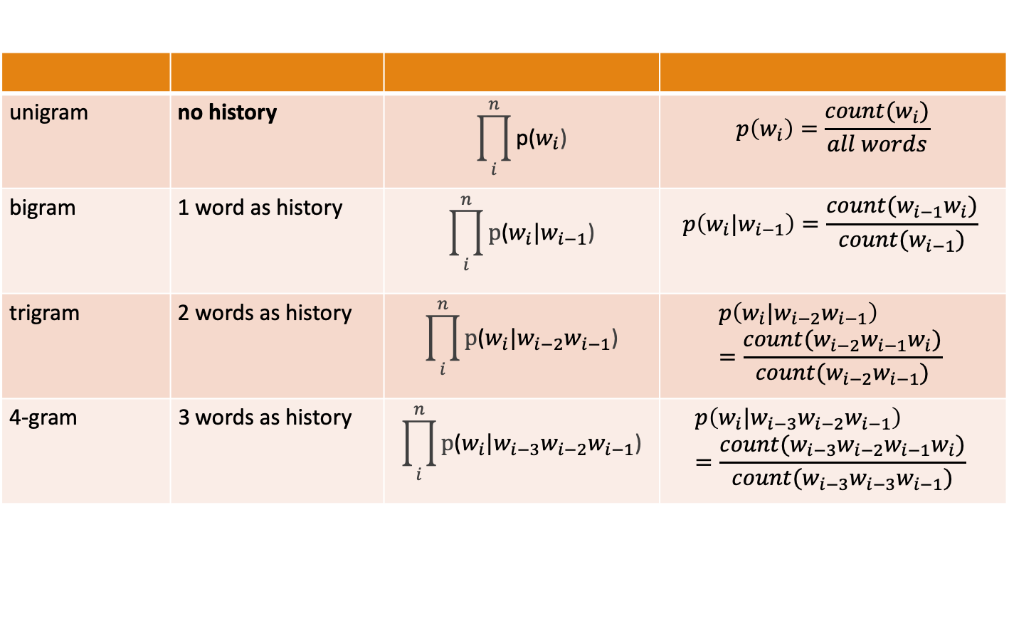
N-Gram Language Models
unigram | no history | $$\prod_{i}^{n}{\text{p}\text{(}w_{i}\text{)}}$$ | $$p\left(w_{i}\right)=\frac{count(w_{i})}{all words}$$
bigram | 1 word as history | $$\prod_{i}^{n}{\text{p}\text{(}w_{i}\text{|}w_{i−1}\text{)}}$$ | $$p\left(w_{i}\text{|}w_{i−1}\right)=\frac{count(w_{i−1}w_{i})}{count(w_{i−1})}$$
trigram | 2 words as history | $$\prod_{i}^{n}{\text{p}\text{(}w_{i}\text{|}w_{i−2}w_{i−1}\text{)}}$$ | $$p\left(w_{i}\text{|}w_{i−2}w_{i−1}\right)=\frac{count(w_{i−2}w_{i−1}w_{i})}{count({w_{i−2}w}_{i−1})}$$
4-gram | 3 words as history | $$\prod_{i}^{n}{\text{p}\text{(}w_{i}\text{|}{w_{i−3}w_{i−2}w}_{i−1}\text{)}}$$ | $$p\left(w_{i}\text{|}{w_{i−3}w_{i−2}w}_{i−1}\right)=\frac{count(w_{i−3}w_{i−2}w_{i−1}w_{i})}{count({w_{i−3}w_{i−3}w}_{i−1})}$$

Slide 13
Smoothing
When we have sparse statistics:
Steal probability mass to generalize better
P(w | denied the)
3 allegations
2 reports
1 claims
1 request
7 total
allegations
attack
man
reports
outcome
…
claims
request
P(w | denied the)
2.5 allegations
1.5 reports
0.5 claims
0.5 request
2 other
7 total
allegations
allegations
attack
man
outcome
reports
…
claims
request
Notes:
Subtract half a count from each observed event, spread the subtracted amount across other unobserved events.

Slide 14
Approximating Shakespeare

Slide 15
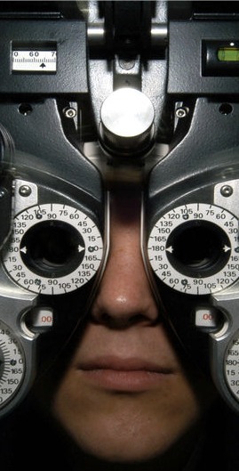
Distributional Hypothesis
If we consider optometrist and eye-doctor we find that, as our corpus of utterances grows, these two occur in almost the same environments. In contrast, there are many sentence environments in which optometrist occurs but lawyer does not...
It is a question of the relative frequency of such environments, and of what we will obtain if we ask an informant to substitute any word he wishes for optometrist (not asking what words have the same meaning).
These and similar tests all measure the probability of particular environments occurring with particular elements... If A and B have almost identical environments we say that they are synonyms.
–Zellig Harris (1954)
Notes:
Similar messages expressed by Wittgenstein (1953) and Firth (1957) who said “You shall know a word by the company it keeps.”
VSMs are interesting especially due to their relation with the distributional hypothesis and related hypotheses. The distributional hypothesis is that words that occur in similar contexts tend to have similar meanings. Efforts to apply this abstract hypothesis to concrete algorithms for measuring the similarity of meaning often lead to vectors, matrices, and higher-order tensors.

Slide 16



Term-Document Matrix
 | D1 | D2 | D3 | D4 | D5
abandon
abdicate
abhor
academic
…
zygodactyl
zymurgy
We can measure
how similar two
documents are
by comparing their
column vectors

Slide 17



Term-Document Matrix
 | D1 | D2 | D3 | D4 | D5
abandon
abdicate
abhor
academic
…
zygodactyl
zymurgy
We can measure
word similarity by
comparing two row vectors
Notes:
It measures the similarity between words!

Slide 18
Sparse Representations
Term-Document Matrices are
long (length |V|= 20,000 to 50,000)
sparse (most elements are zero)

Slide 19
Word embeddings
We shifted vectors which are
short (length 50-1000)
dense (most elements are non-zero)
learned representations (not just counts)

Slide 20
Word2Vec Training
Training sentence:
... lemon, a tablespoon of apricot jam a pinch ...
c1 c2 t c3 c4
Training data: input/output pairs centering on apricot
Assume a +/- 2 word window
Notes:
OK, so now we have a way of computing the probability of p(+ | t, c), he probability that c is a real context word for t. BUT, we need embeddings for t and c to do it.

Slide 21
Word2Vec Training
Training sentence:
... lemon, a tablespoon of apricot jam a pinch ...
c1 c2 t c3 c4
For each positive example, we'll create k negative examples.
Using noise words
Any random word that isn't t
Notes:
Start with V random 300-dimensional vectors as initial embeddings
Use logistic regression, the second most basic classifier used in machine learning after naïve Bayes

Slide 22
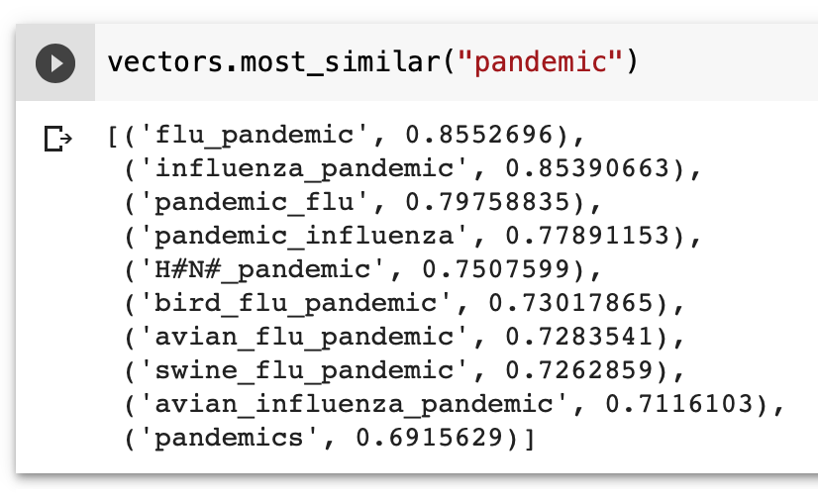
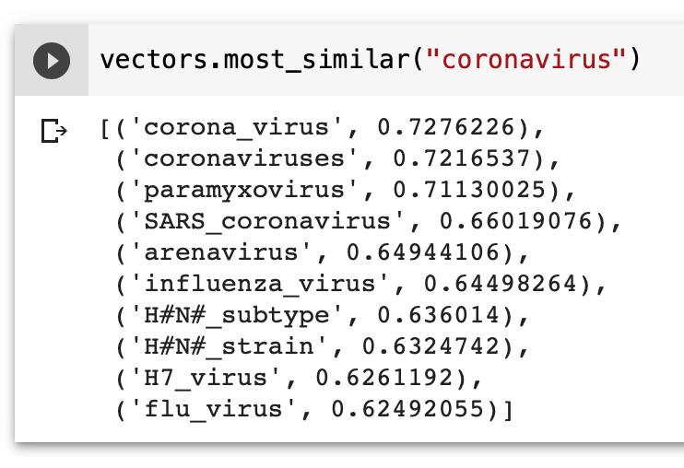
k-Nearest Neighbors

Slide 23
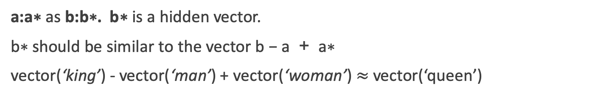
Word Analogies
a:a∗ as b:b∗. b∗ is a hidden vector.
b∗ should be similar to the vector b − a + a∗
vector(‘king’) - vector(‘man’) + vector(‘woman’) $≈$vector(‘queen’)
king
-man
+woman
queen
man
woman
Notes:
Analogy Another semantic property of embeddings is their ability to capture re- lational meanings. Mikolov et al. (2013b) and Levy and Goldberg (2014b) show that the offsets between vector embeddings can capture some analogical relations between words. For example, the result of the expression vector(‘king’) - vec- tor(‘man’) + vector(‘woman’) is a vector close to vector(‘queen’); the left panel in Fig. 6.14 visualizes this, again projected down into 2 dimensions. Similarly, they found that the expression vector(‘Paris’) - vector(‘France’) + vector(‘Italy’) results in a vector that is very close to vector(‘Rome’).

Slide 24
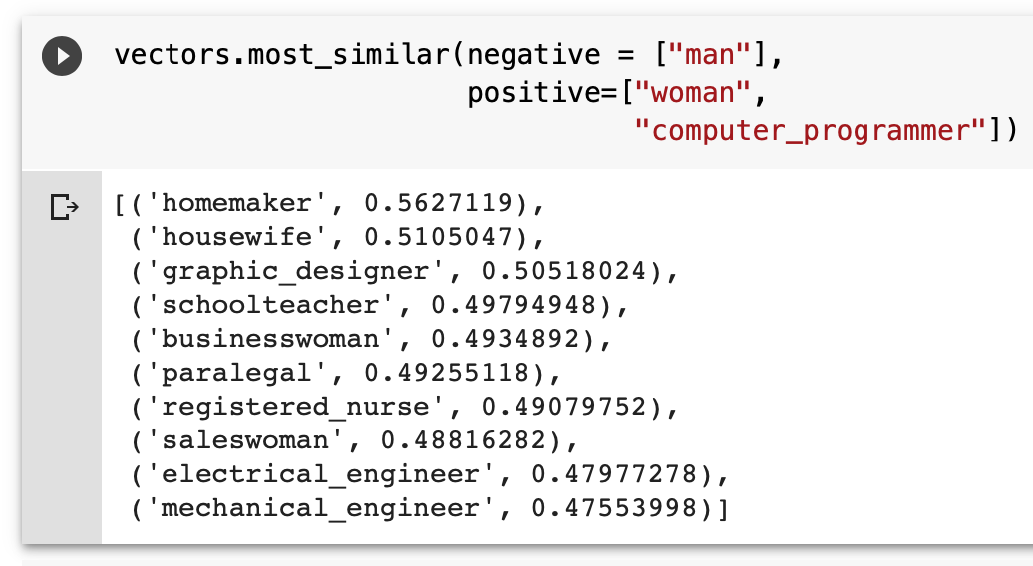
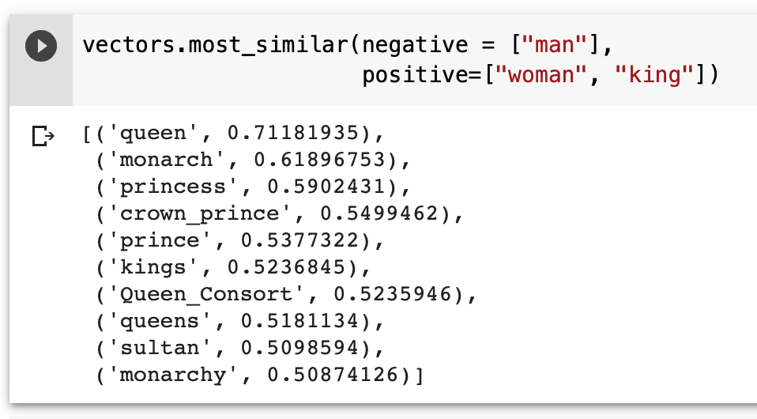
Word Analogies
a:a∗ as b:b∗. b∗ is a hidden vector.
b∗ should be similar to the vector b − a + a∗
vector(‘king’) - vector(‘man’) + vector(‘woman’) $≈$vector(‘queen’)
king
-man
+woman
queen
man
woman
Notes:
Analogy Another semantic property of embeddings is their ability to capture re- lational meanings. Mikolov et al. (2013b) and Levy and Goldberg (2014b) show that the offsets between vector embeddings can capture some analogical relations between words. For example, the result of the expression vector(‘king’) - vec- tor(‘man’) + vector(‘woman’) is a vector close to vector(‘queen’); the left panel in Fig. 6.14 visualizes this, again projected down into 2 dimensions. Similarly, they found that the expression vector(‘Paris’) - vector(‘France’) + vector(‘Italy’) results in a vector that is very close to vector(‘Rome’).

Slide 25



Magnitude: Python Toolkit for Manipulating Embeddings

Slide 26
Monolingual Word Embeddings
Monday
cat
Friday
dog
Baltimore

Slide 27
Monolingual Word Embeddings
kucing
anjing
Baltimore
Monday
cat
Friday
dog
Baltimore
senen
jumat

Slide 28
Bilingual Word Embeddings
cat
kucing
Monday
senen
anjing
Friday
dog
jumat
baltimore
Baltimore

Slide 29
Projecting Vector Space Models

Slide 30
Projecting Vector Space Models

Slide 31
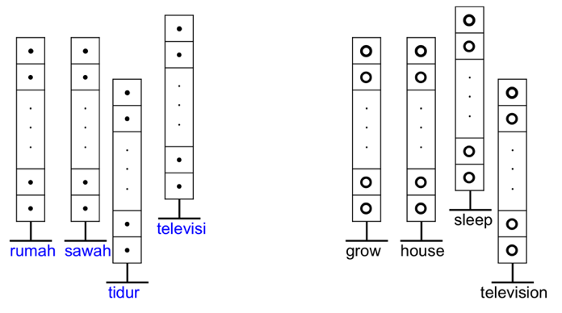
Word Embeddings
Instead of high dimensional vector space models used by Rapp and others in the past, we use low-dimensional word embeddings.

Slide 32
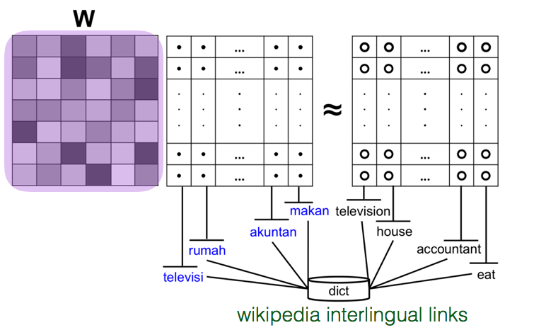
Learning Bilingual Embeddings
mapping function W
Notes:
Goal learn a mapping function W that maps the target language vectors in the seed translations to their corresponding souce language vectors.

Slide 33
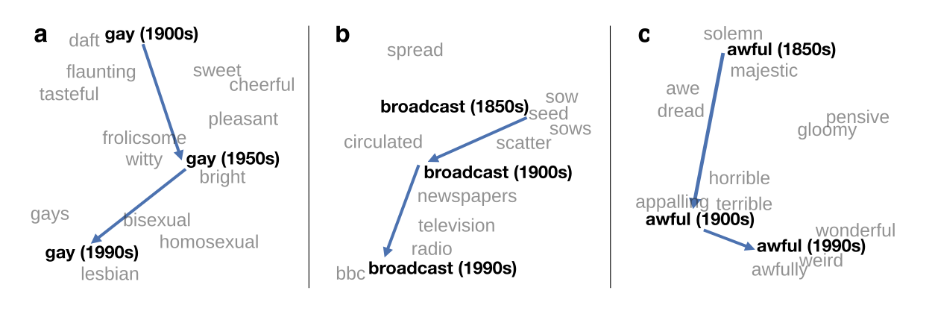
Use in Historical Linguistics
~30 million books, 1850-1990, Google Books data
Notes:
visualization of the semantic change of 3 words in English using
Figure 5à: Two-dimensional visualization of semantic change in English using SGNS word2vec vectors. The modern sense of each word, and the grey context words, are com-
vectors see Section 5à8 for the visualization algorithm à A, The word gay shifted puted from the most recent (modern) time-point embedding space. Earlier points are com-
from meaning ÒcheerfulÓ or ÒfrolicsomeÓ to referring to homosexualityà A, In the early puted from earlier historical embedding spaces. The visualizations show the changes in the
2àth century broadcast referred to Òcasting out seedsÓà with the rise of television and word gay from meanings related to “cheerful” or “frolicsome” to referring to homosexuality,
radio its meaning shifted to Òtransmitting signalsÓà C, Awful underwent a process of the development of the modern “transmission” sense of broadcast from its original sense of
pejoration, as it shifted from meaning Òfull of aweÓ to meaning Òterrible or appallingÓ
sowing seeds, and the pejoration of the word awful as it shifted from meaning “full of awe” t2om2eàaning “terrible or appalling”

Slide 34
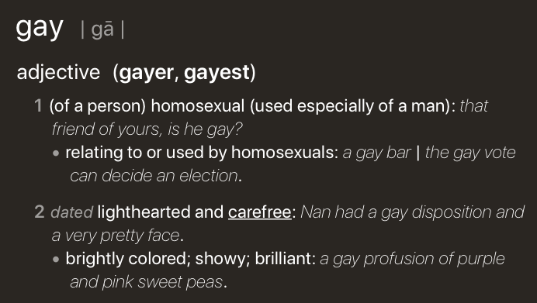
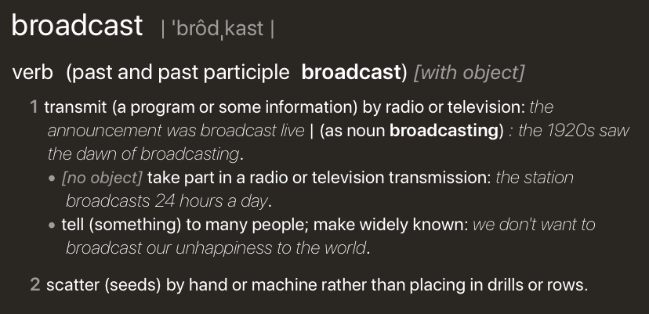
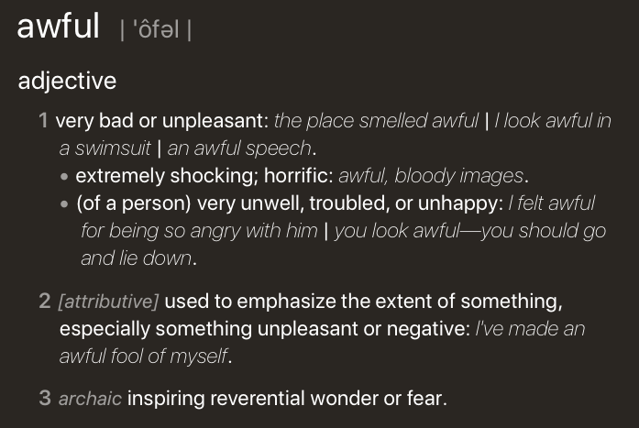
Use in Historical Linguistics
~30 million books, 1850-1990, Google Books data
Notes:
visualization of the semantic change of 3 words in English using
Figure 5à: Two-dimensional visualization of semantic change in English using SGNS word2vec vectors. The modern sense of each word, and the grey context words, are com-
vectors see Section 5à8 for the visualization algorithm à A, The word gay shifted puted from the most recent (modern) time-point embedding space. Earlier points are com-
from meaning ÒcheerfulÓ or ÒfrolicsomeÓ to referring to homosexualityà A, In the early puted from earlier historical embedding spaces. The visualizations show the changes in the
2àth century broadcast referred to Òcasting out seedsÓà with the rise of television and word gay from meanings related to “cheerful” or “frolicsome” to referring to homosexuality,
radio its meaning shifted to Òtransmitting signalsÓà C, Awful underwent a process of the development of the modern “transmission” sense of broadcast from its original sense of
pejoration, as it shifted from meaning Òfull of aweÓ to meaning Òterrible or appallingÓ
sowing seeds, and the pejoration of the word awful as it shifted from meaning “full of awe” t2om2eàaning “terrible or appalling”

Slide 35
Uses in Social Science
Change in association of Chinese names with adjectives framed as "othering" (barbaric, monstrous, bizarre)
Notes:
This shows the relative strength of the Asian association for words used to describe outsiders over time. As opposed to the adjectives overall, which see two distinct phase shifts in Asian association, the words related to outsiders steadily decrease in Asian association over time—except around World War II—indicating that broader globalization trends led to changing attitudes with regard to such negative portrayals. Overall, the word embeddings exhibit a remarkable change in adjectives and attitudes toward Asian Americans during the 20th century.

Slide 36
What should a semantic model be able to do?
Goals for Distributional Semantics
Notes:
1. A semantic model should capture how language relates to the world via sensory perception (grounding)
2. A semantic model should be able to generalize to new situations (connecting concepts, referents, and logical denotations)
3. A semantic model should robustly hand vagueness (situations when it is unclear whether an entity is a referent of a concept)
4. A semantic model should handle words with multiple senses (polysemy) and encode relationships like hyponym between words/word senses
5. Word representations should be able to be combined to encode the meanings of sentences (compositionally) through a better process than component wise multiplication (which is commutative and therefore loses word order)
6. A semantic model should support local notions of truth and entailment (one proposition follows from another).
7. A semantic model should be able to capture how word meaning depends on context.

Slide 37
Goal: Word Sense

Slide 38
Goal: Hypernomy
One goal of for a semantic model is to represent the relationship between words. A classic relation is hypernomy which describes when one word (the hypernym) is more general than the other word (the hyponym).

Slide 39
Goal: Compositionality
Language is productive. We can understand completely new sentences, as long as we know each word in the sentence. One goal for a semantic model is to be able to derive the meaning of a sentence from its parts, so that we can generalize to new combinations. This is known as compositionality.

Slide 40
Goal: Grounding
Many experimental studies in language acquisition suggest that word meaning arises not only from exposure to the linguistic environment but also from our interaction with the physical world. Use collections of documents that contain pictures
Notes:
Image partitioned into regions of varying granularity using (a) the normalized cut image segmentation algo- rithm, (b) uniform grid segmentation, and (c) the SIFT point detector.

Slide 41
A semantic model should
Handle words with multiple senses (polysemy) and encode relationships like hyponym between words/word senses
Robustly handle vagueness (situations when it is unclear whether an entity is a referent of a concept)
Should be able to be combined word representations to encode the meanings of sentences (compositionally)
Capture how word meaning depends on context.
Support logical notions of truth and entailment
Generalize to new situations (connecting concepts and referents)
Capture how language relates to the world via sensory perception (grounding)

Slide 42
Neural networks
Notes:
The neurons are connected to each other, forming a network: the output of a neuron may feed into the inputs of one or more neurons. Such networks were shown to be very capable computational devices. If the weights are set correctly, a neural network with enough neurons and a nonlinear activation function can approximate a very wide range of mathematical functions (we will be more precise about this later).
A typical feed-forward neural network may be drawn as shown. Each circle is a neuron, with incoming arrows being the neuron’s inputs and outgoing arrows being the neuron’s outputs. Each arrow carries a weight, reflecting its importance (not shown). Neurons are arranged in layers, reflecting the flow of information. The bottom layer has no incoming arrows, and is
the input to the network. the top-most layer has no outgoing arrows, and is the output of the network. The other layers are considered “hidden.” thee sigmoid shape inside the neurons in the middle layers represent a nonlinear function (i.e., the logistic function) that is applied to the neuron’s value before passing it to the output. In the figure, each neuron is connected to all of the neurons in the next layer—this is called a fully connected layer or an affine layer.

Slide 43
Neural network LMs
W_{t-1})
Notes:
a feedforward neural language model moving through a text. At each timestep t the network takes the 3 context words, converts each to a d-dimensional embedding, and concatenates the 3 embeddings together to get the 1×Nd unit input layer x for the network. These units are multiplied by a weight matrix W and bias vector b and then an activation function to produce a hidden layer h, which is then multiplied by another weight matrix U. (For graphic simplicity we don’t show b in this and future pictures.)

Slide 44
Recurrent Neural Networks
A recurrent neural network (RNN) is any network that contains a cycle within its network.
In such networks the value of a unit can be dependent on earlier outputs as an input.
RNNs have proven extremely effective when applied to NLP.
Notes:
The hidden layer includes a recurrent connection as part of its input. That is, the activation value of the hidden layer depends on the current input as well as the activation value of the hidden layer from the previous time step.
The figure illustrates the structure of a simple RNN. As with ordinary feedforward networks, an input vector representing the current input element, xt , is multiplied by a weight matrix and then passed through an activation function to compute an activation value for a layer of hidden units. This hidden layer is, in turn, used to calculate a corresponding output, yt . In a departure from our earlier window-based approach, sequences are processed by presenting one element at a time to the network. The key difference from a feedforward network lies in the recurrent link shown in the figure with the dashed line. This link augments the input to the computation at the hidden layer with the activation value of the hidden layer from the preceding point in time.

Slide 45
Sequence Classifiers
Notes:
Sequence classification using a simple RNN combined with a feedforward net- work. The final hidden state from the RNN is used as the input to a feedforward network that performs the classification.
Note that in this approach there are no intermediate outputs for the words in the sequence preceding the last element. Therefore, there are no loss terms associ- ated with those elements. Instead, the loss function used to train the weights in the network is based entirely on the final text classification task. Specifically, the out- put from the softmax output from the feedforward classifier together with a cross- entropy loss drives the training. The error signal from the classification is backprop- agated all the way through the weights in the feedforward classifier through, to its input, and then through to the three sets of weights in the RNN. This combination of a simple recurrent network with a feedforward classifier is our first example of a deep neural network. And the training regimen that uses the loss from a downstream application to adjust the weights all the way through the network is referred to as end-to-end training.

Slide 46
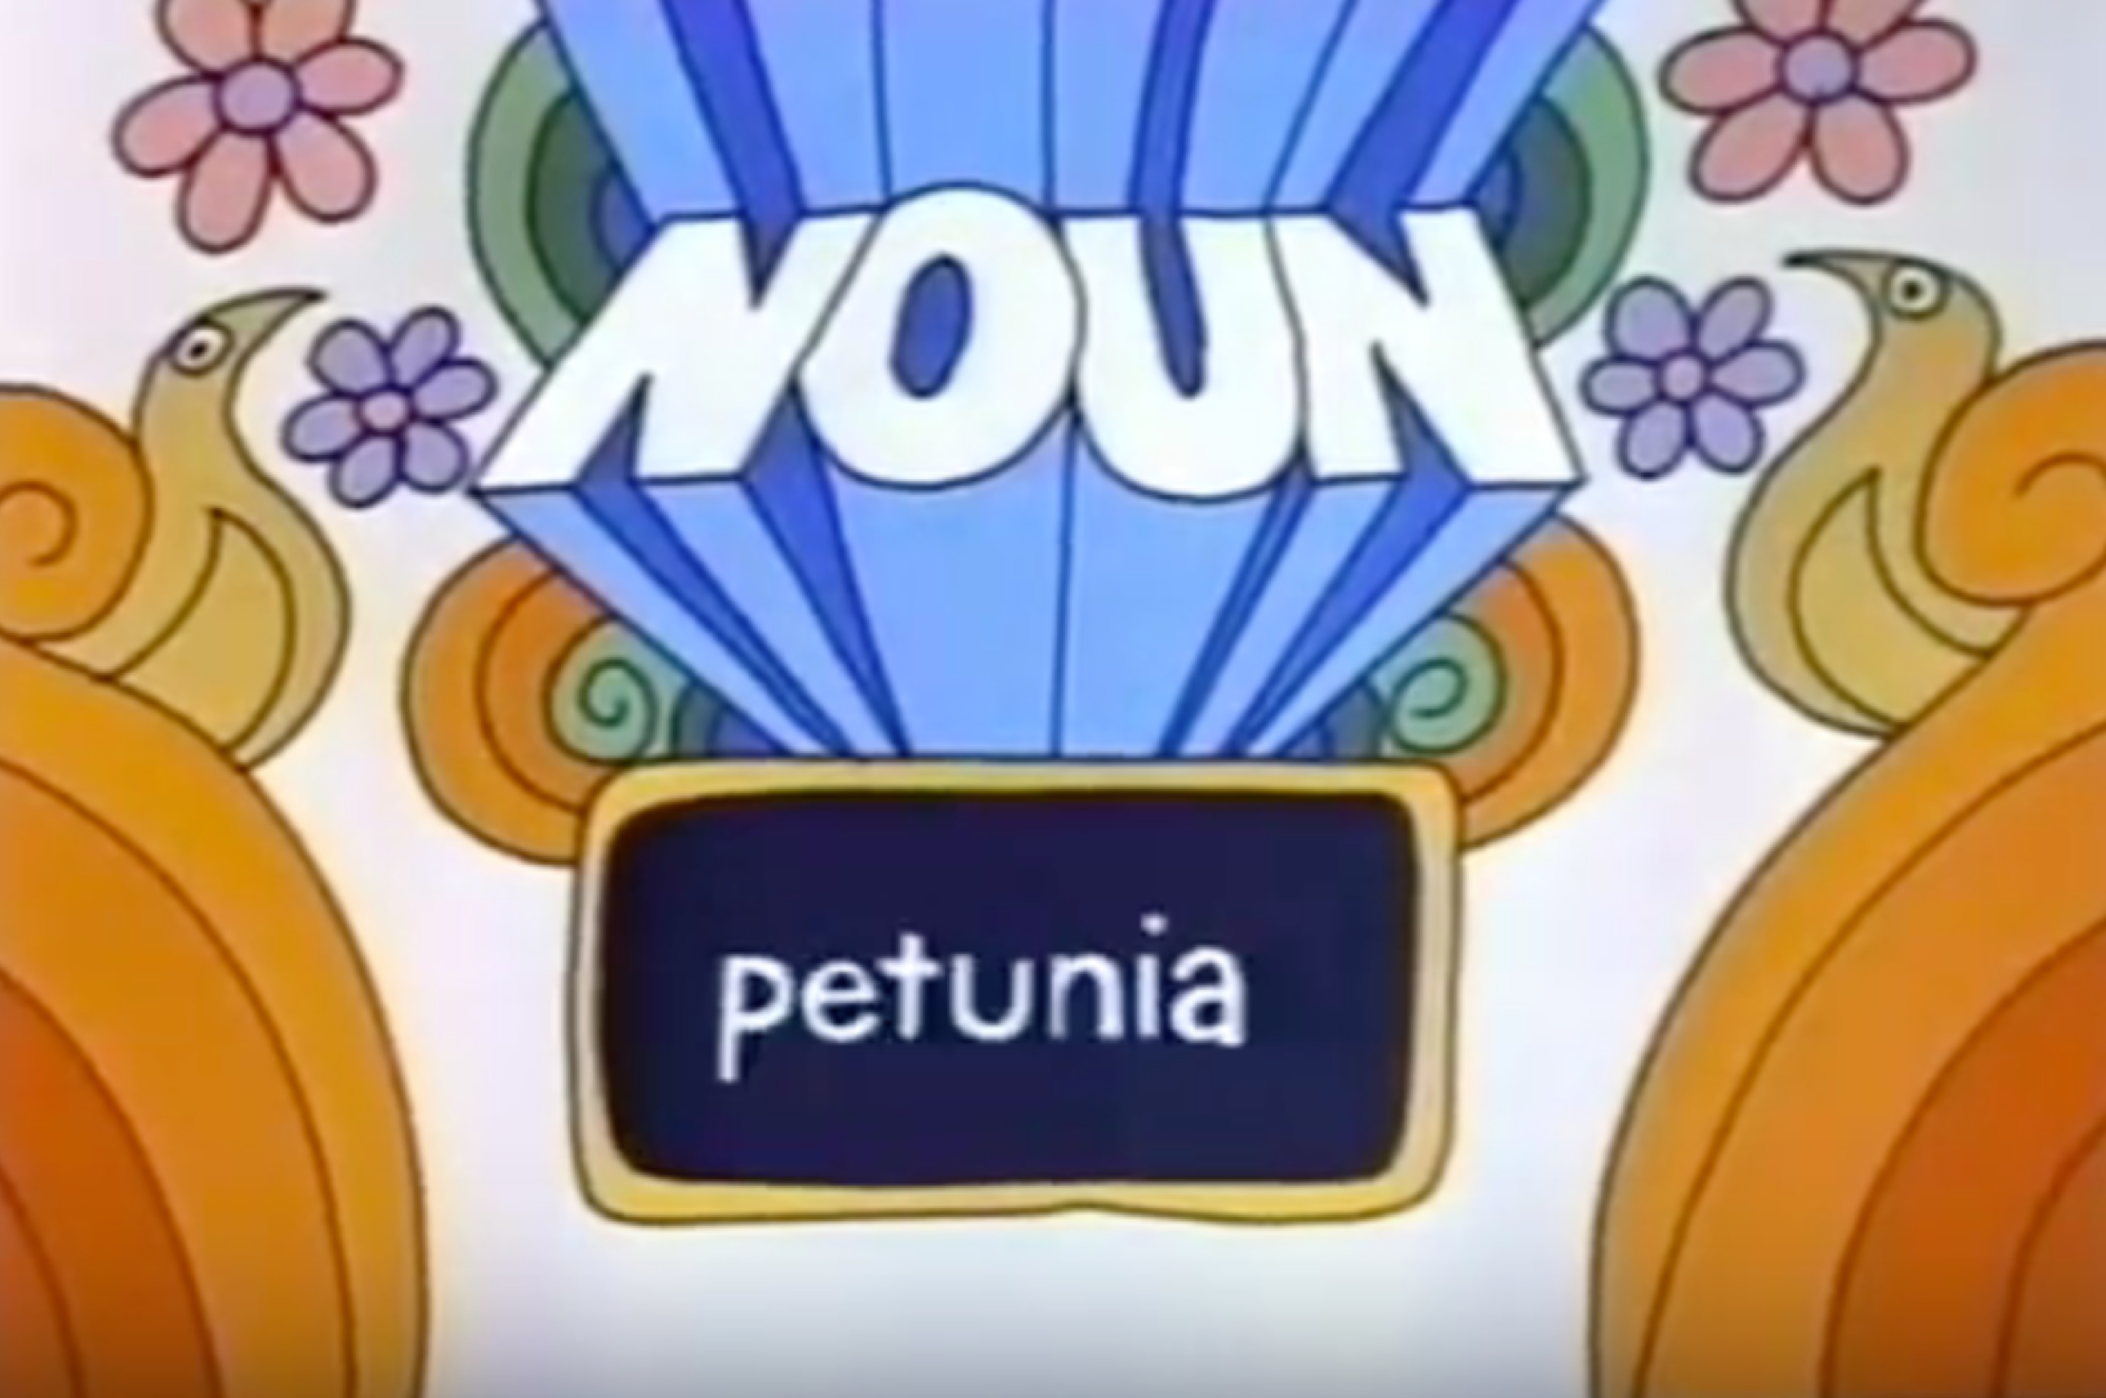
Sequence Models
A sequence model or sequence classifier is a model whose job is to assign a label or class to each unit in a sequence, thus mapping a sequence of observations to a sequence of labels.
Noun
Verb
Pronoun
Preposition
Adverb
Conjunction
Adjective
Interjection

Slide 47
Tag | Description | Example | Tag | Description | Example
CC | coordinating conjunction | and, but, or | SYM | symbol | +, %, &
CD | cardinal number | one, two | TO | “to” | to
DT | determiner | a, the | UH | interjection | ah, oops
EX | existential “there” | there | VB | verb base form | eat
FW | foreign word | mea culpa | VBD | verb past tense | ate
IN | proposition/sub-conj | of, in, by | VBG | verb gerund | eating
JJ | adjective | yellow | VBN | verb past participle | eaten
JJR | comparative adjective | bigger | VBP | verb non-3sg pres | eat
JJS | superlative adjective | wildest | VBZ | verb 3sg pres | eats
LS | list item marker | 1, 2, One | WDT | wh-determiner | which, that
MD | modal | can, should | WP | wh-pronoun | what, who
NN | noun, singular or mass | llama | WP$ | possessive wh- | whose
NNS | noun, plural | llamas | WRB | wh-adverb | how, where
NNP | proper noun, sing. | IBM | $ | dollar sign | $
NNPS | proper noun, plural | Carolinas | # | pound sign | #
PDT | predeterminer | all, both | “ | left quote | ‘ or “
POS | possessive ending | ‘s | ” | right quote | ’ or ”
PRP | personal pronoun | I, you, we | ( | left parenthesis | [, (, {, <
PRP$ | possessive pronoun | your, one’s | ) | right parenthesis | ], ), }, >

Slide 48
POS Tagging
Words are ambiguous, so tagging must resolve disambiguate.
The amount of tag ambiguity for word types in the Brown and WSJ corpora from the Treebank-3 (45-tag) tagging. These statistics include punctuation as words, and assume words are kept in their original case.
Types: | WSJ | Brown
Unambiguous (1 tag) | 44,432 (86%) | 45,799 (85%)
Ambiguous (2+ tags) | 7,025 (14%) | 8,050 (15%)
Tokens:
Unambiguous (1 tag) | 577,421 (45%) | 384,349 (33%)
Ambiguous (2+ tags) | 711,780 (55%) | 786,646 (67%)
Notes:
CCB – redo this as a graph?

Slide 49
Most frequent class baseline
Many words are easy to disambiguate, because their different tags aren’t equally likely.
Simplistic baseline for POS tagging: given an ambiguous word, choose the tag which is most frequent in the training corpus.
Most Frequent Class Baseline: Always compare a classifier against a baseline at least as good as the most frequent class baseline (assigning each token to the class it occurred in most often in the training set).
Notes:
For example a can be the determiner, or the letter, but the determiner is much more likely.

Slide 50
Tag Sequences
Notes:
Part of speech tagging with a simple RNN

Slide 51
Stacked RNNs
Notes:
Stacked RNNs consist of multiple networks where the output of one layer serves as the input to a subsequent layer,
has been demonstrated across numerous tasks that stacked RNNs can outper- form single-layer networks. One reason for this success has to do with the network’s ability to induce representations at differing levels of abstraction across layers. Just as the early stages of the human visual system detect edges that are then used for finding larger regions and shapes, the initial layers of stacked networks can induce representations that serve as useful abstractions for further layers — representations that might prove difficult to induce in a single RNN.

Slide 52
Bidirectional RNNs

Slide 53
Bidirectional RNNs for sequence classification

Slide 54
Syntactic Parsing
Notes:
Another example: We saw the Eiffel Tower flying to Paris.

Slide 55
Ambiguity
Ambiguity can arise because of words with multiple senses or POS tags. Many kinds of ambiguity are also structural.

Slide 56
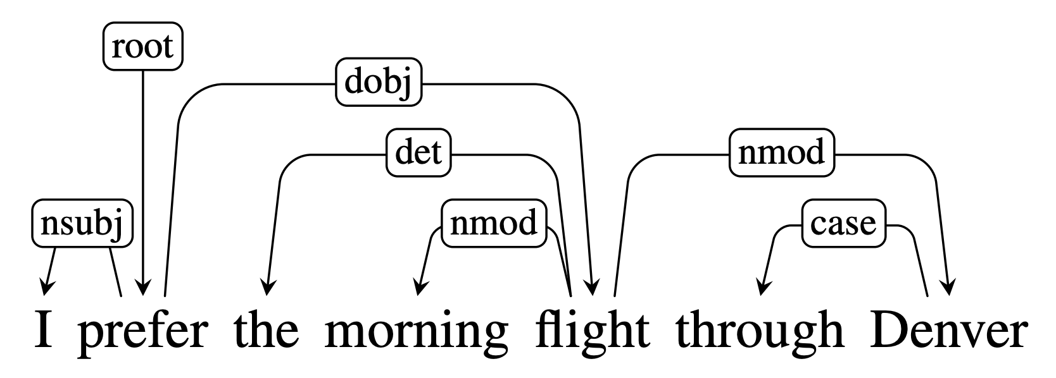
Dependency Grammars
Dependency grammars depict the syntactic structure of sentences solely in terms of the words in a sentence and an associated set of directed head-dependent grammatical relations that hold among these words.

Slide 57
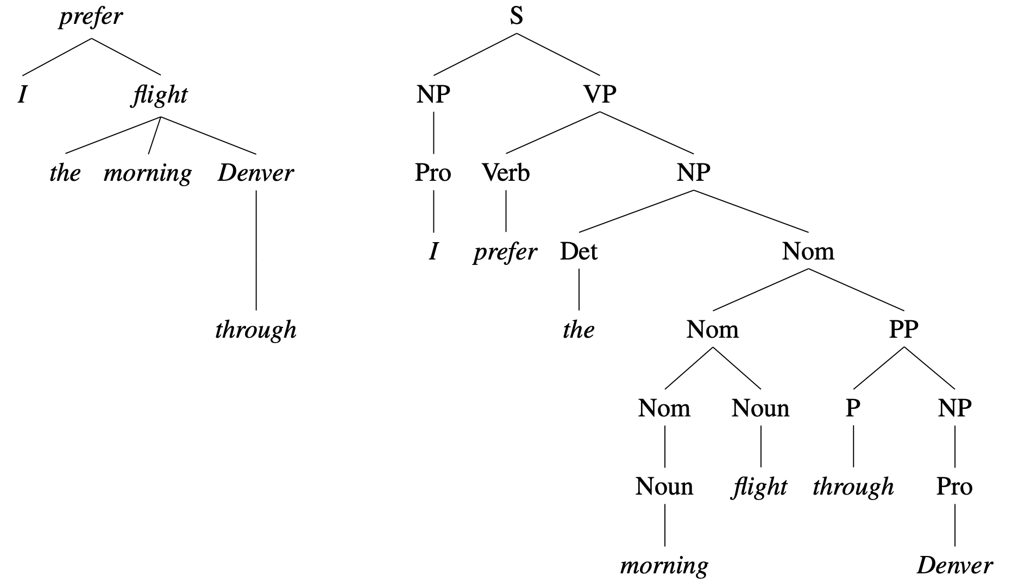
Dependency – based
Constituent– based
Notes:
Unlabeled

Slide 58
Open Information Extraction
Unsupervised relation extraction
Find all strings of words that satisfy the tripe relation.
United has a hub in Chicago, which is the headquarters of United Continental Holdings.
r1: <United, has a hub in, Chicago>
r2: <Chicago, is the headquarters of, United Continental Holdings>

Slide 59
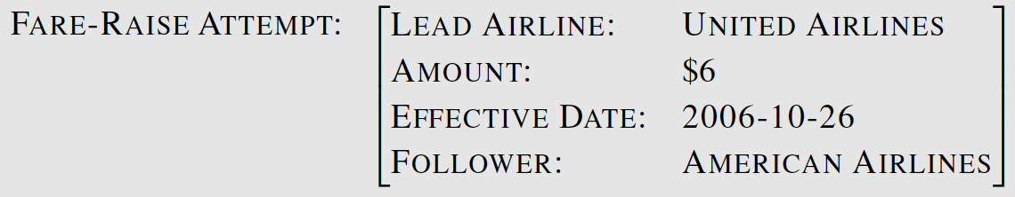
Template Filling
Citing high fuel prices, United Airlines said Friday it has increased fares by $6 per round trip on flights to some cities also served by lower cost carriers. American Airlines, a unit of AMR Corp., immediately matched the move, spokesman Tim Wagner said. United, a unit of UAL Corp., said the increase took effect Thursday and applies to most routes where it competes against discount carriers, such as Chicago to Dallas and Denver to San Francisco.

Slide 60
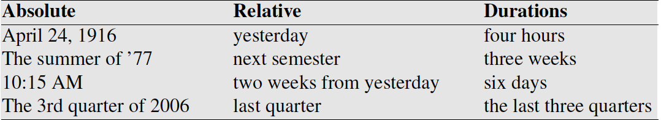
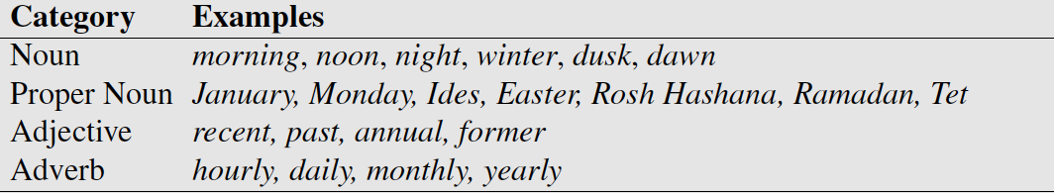
Temporal Expression Extraction
Lexical triggers for temporal expressions:
Temporal expression recognition
Temporal normalization
mapping a temporal expression to either normalization a specific point in time or to a duration
Notes:
Temporal normalization is the process of mapping a temporal expression to either a specific point in time or to a duration. Points in time correspond to calendar dates, to times of day, or both. Durations primarily consist of lengths of time but may also include information about start and end points.

Slide 61
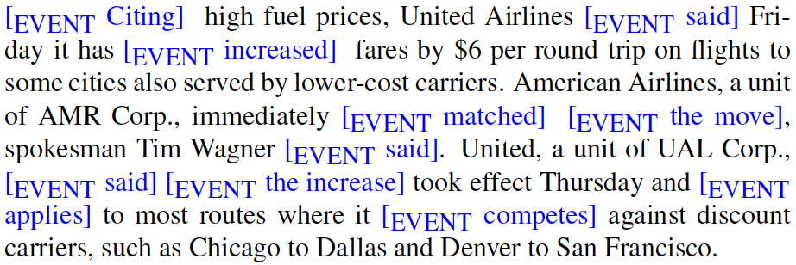
Event Extraction
Events can be classified as actions, states, reporting events, perception events, etc. The aspect, tense, and modality of each event also needs to be extracted.
Notes:
Reporting events:
Events are to be classified as actions, states, reporting events (say, report, tell, explain), perception events, and so on. The aspect, tense, and modality of each event also needs to be extracted.

Slide 62
Temporal ordering of events
Delta Air Lines earnings soared 33% to a record in the fiscal first quarter, bucking the industry trend toward declining profits.
Soaring_{e1} is included in the fiscal first quarter_{t58}
Soaring_{e1} is simultaneous with the bucking_{e3}
Declining_{e4} includes soaring_{e1}

Slide 63
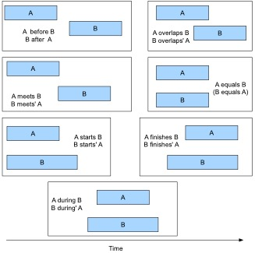

Slide 64
Desirable Properties for Meaning Representations
Verifiability – compare some meaning representation (MR) to a representation in a knowledge base (KB).
Unambiguous Representations – each ambiguous natural language meaning corresponds to a separate MR
Canonical Forms – paraphrases are collapsed to one MR
Make Inferences – draw valid conclusions based on the MR of inputs and its background knowledge in KB
Match variables – variables can be replaced by some object in the KB so an entire proposition will then match

Slide 65

Unambiguous representation
I want to eat someplace that’s near Penn’s campus.

Slide 66
Model-Theoretic Semantics
A model allows us to bridge the gap between a formal representation and the world. The model stands in for a particular state of affairs in the world.
The domain of a model is the set of objects that are being represented. Each distinct thing (person, restaurant, cuisine) corresponds to a unique element in the domain
Properties of objects (like whether a restaurant is expensive) in a model correspond to sets of objects.
Relations between object (like whether a restaurant serves a cuisine) are are sets of tuples.

Slide 67
Notes:
The names for our domain elements are deliberately using meaningless, non-mnemonic to emphasize the fact that whatever it is that we know about these entities has to come from the formal properties of the model and not from the names of the symbols.

Slide 68
Katie likes Rio
Katie → c
Rio → g
likes → Likes
<c,g> ∈ Likes so Katie likes Rio
is True
Notes:
Each element of the vocabulary must have a denotation in the model, meaning that every element corresponds to a fixed, well-defined part of the model.
The function that maps from the vocabulary to the proper denotations in the model is an interpretation.

Slide 69
First-Order Logic
FOL is a meaning representation language that satisfies the desirable qualities that we outlined. It provides a computational basis for verifiability and inference.
It doesn’t have many requirements other than the represented world consists of objects, properties of objects, and relations among objects.

Slide 70
Logical Connectives
We can conjoin formula with logical connectives like and (∧), or (∨), not (¬), and implies (⇒)
Each one has a truth table:

Slide 71
Quantifiers
All restaurants in Philly are closed.
∀xRestaurant(x) ∧ Is((LocationOf(x), Philadelphia) ⇒ Closed(x)
The ∀ operator states that for the logical formula to be true, the substitution of any object in the knowledge base for the universally quantified variable should result in a true formula.

Slide 72
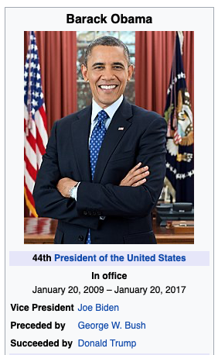
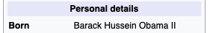
Value of Logical Representation of Sentences
Is Barack Obama a US Citizen?
Citizen_Of(Barack_Obama, United_States)
∀x Person(x) ∧ Born-In(x, y) ∧ Located-In(y, United_States) ⇒ Citizen_Of(x, United_States)
Person(Barack_Obama) ∧
Born-In(Barack_Obama, Hawaii) ∧
Located-In(Hawaii, United_States)
Citizen_Of(Barack_Obama, United_States)
Notes:
Inference via Modus ponens
antecedent is true, so consequent is true
Backward chaining
Hawaiʻi was admitted as a U.S. state on August 21, 1959. And it was a US Territory since 1898.
Obama was born on August 4, 1961

Slide 73
Encoder-Decoder Models
Machine Translation

Slide 74
Generation with an RNN LM

Slide 75
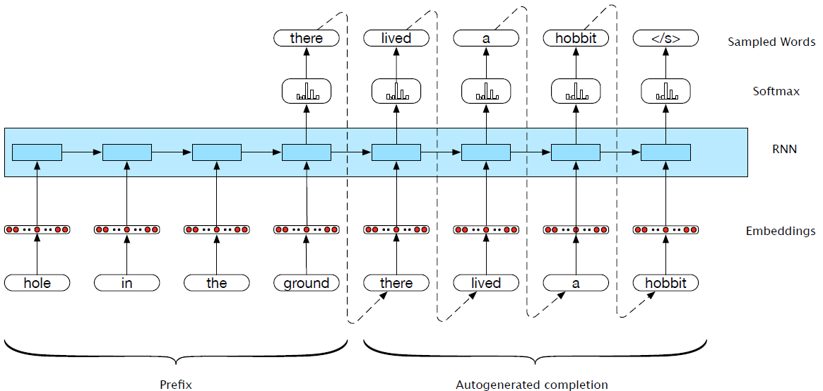
Generation with prefix
Notes:
What about generating from a specified prefix?
Now, let’s consider a simple variation on auto-regressive generation scheme. Instead of having the language model generate a sentence from scratch, we have it complete a sequence given a specified prefix. More specifically, we first pass the specified prefix through the language model using forward inference to produce a sequence of hidden states, ending with the hidden state corresponding to the last word of the prefix. We then begin generating as we did earlier, but using the final hidden state of the prefix as our starting point. The result of this process is a novel output sequence that should
be a reasonable completion of the prefix input.

Slide 76
Machine Translation
Translation from one language to another
ペンシルベニア大学で講演をしています。
I'm giving a talk at University of Pennsylvania

Slide 77
Conversational Agents aka Dialogue Systems
Digital Assistants
Answering questions on websites
Communicating with robots
Chatting for fun
Clinical uses
Notes:
(Siri, Alexa, Cortana, Google Home)

Slide 78
Neural Chatbots
Think of response generation as a task of transducing from the user’s prior turn to the system’s turn
Response generation using encoder-decoder models
Train a deep neural network
Map from user1 turn to user2 response

Slide 79
Current state of the art neural LMs
ELMo
GPT
BERT
GPT-2
Notes:
ELMo: Embeddings from Language Models
GPT: Improving Language Understanding by Generative PreTraining
BERT: Bidirectional Encoder Representations from Transformers.

Slide 80
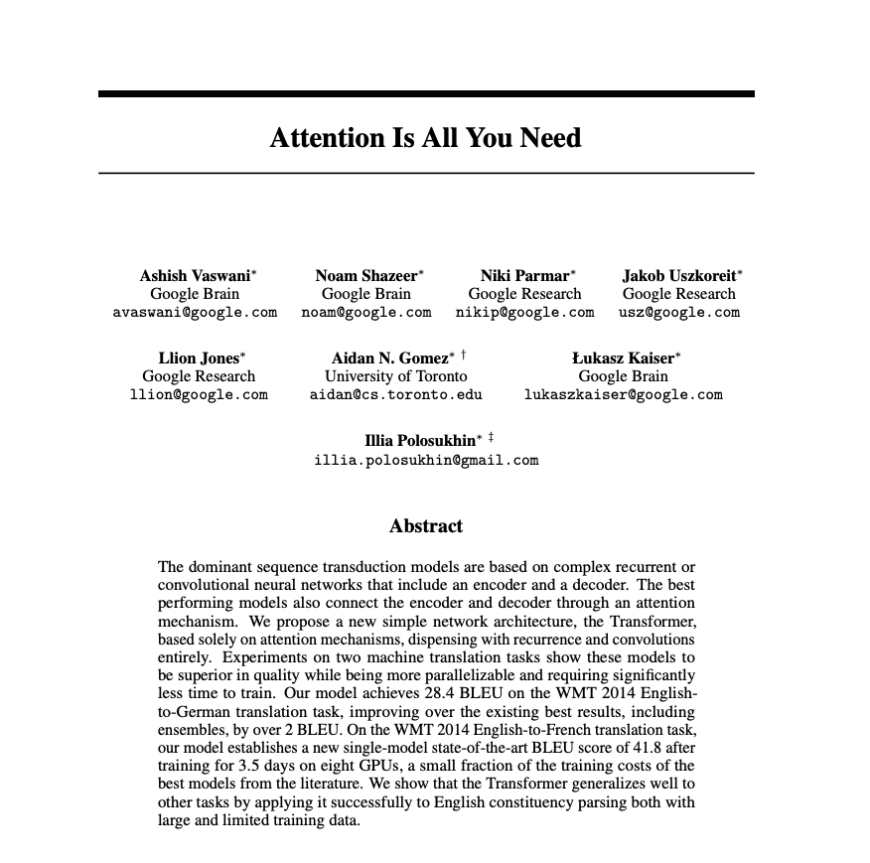
Attention
Weaknesses of the context vector:
Only directly available at the beginning of the process and its influence will wane as the output sequence is generated
Context vector is a function (e.g. last, average, max, concatenation) of the hidden states of the encoder. This approach loses useful information about each of the individual encoder states
Potential solution: attention mechanism
Notes:
With this, we finally have a fixed-length context vector that takes into account information from the entire encoder state that is dynamically update to reflect the needs of the decoder at each step of decoding

Slide 81
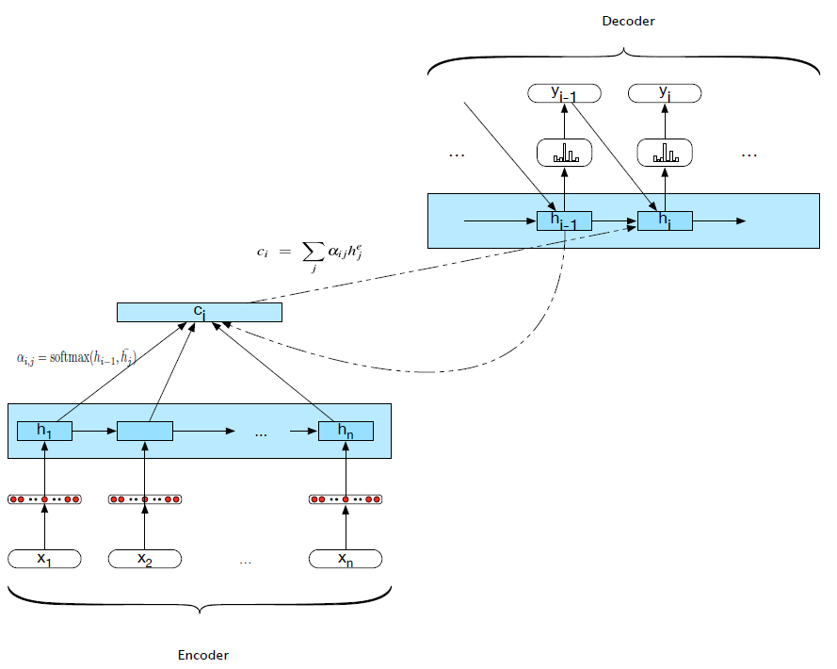
Attention mechanism

Slide 82
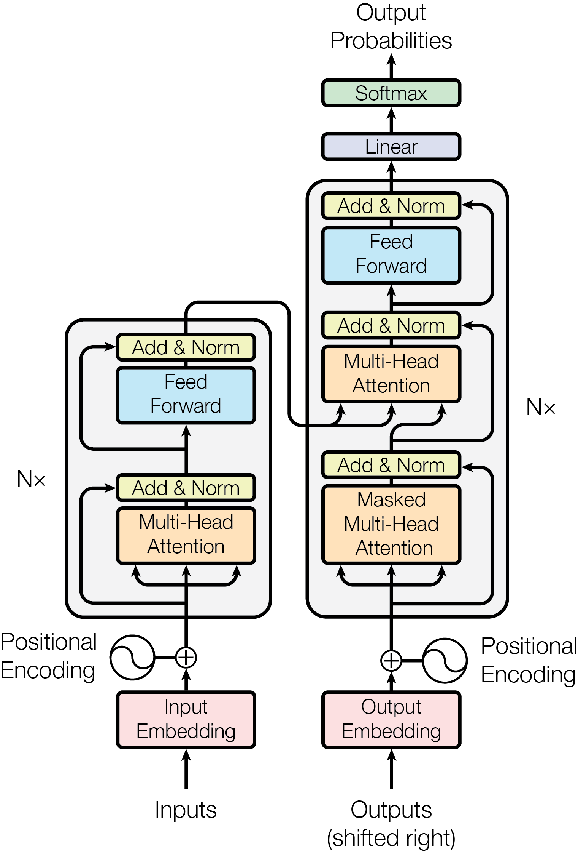
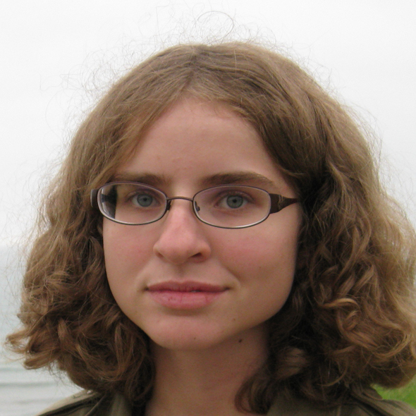
Transformer Architecture

Slide 83
Bidirectional Encoder Representations from Transformers (BERT)
Credit: http://jalammar.github.io/illustrated-bert/

Slide 84
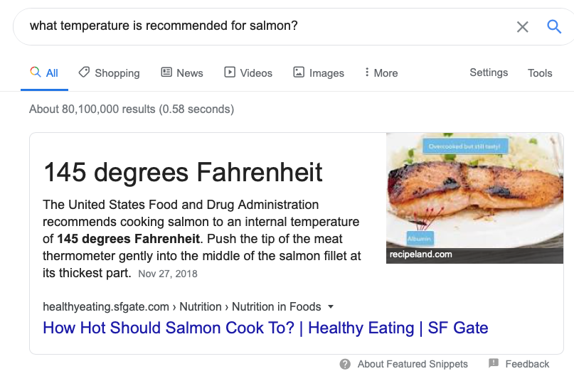
Question Answering

Slide 85
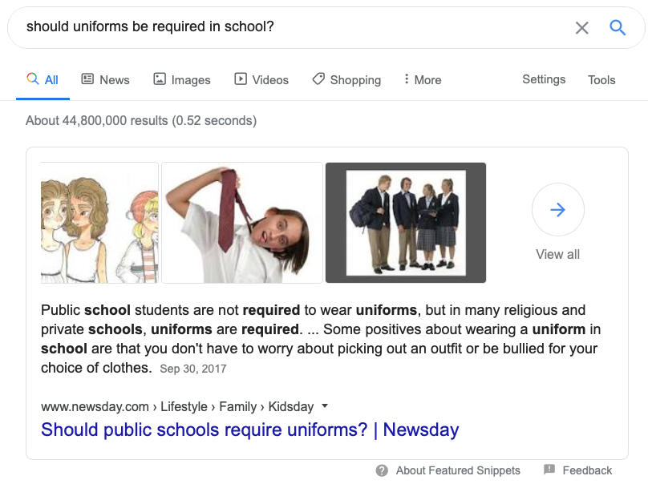
Question Answering

Slide 86

HW10 - NMT
🥇 | Yue, Yuezhan
🥈 | Pengrui, Yinhong
🥉 | Ji-Eun, Rajalakshmi
HW8 - Hypernyms
🥇 | Jundong, Zitong
🥈 | Pedro, Suyog
🥉 | Bowen, Keyu
HW7 - NER
🥇 | Yuan
🥈 | Pengrui, Yinhong
🥉 | Bowen, Keyu
HW6 - Neural LMs
🥇 | Pengrui, Tien
🥈 | Pengrui, Nupur
🥉 | Weichen, Yinuo
HW5 - Clustering
🥇 | Sai, Rutuja
🥈 | Fang, Bo
🥉 | Shubham, Nupur
HW5 - without k
🥇 | Bo, Hang
🥈 | Sai, Rutuja
🥉 | Aayush, Shiping
HW3 – N-Gram LMs
🥇 | Pengrui, Tien
🥈 | Worthan, Josepth
🥉 | Hanbang
HW2 - Text Classif.
🥇 | Yue, Yuezhan
🥈 | Ashish, Vikas
🥉 | Sri, Simmi
HW2 - extra data
🥇 | Ashish, Vikas
🥈 | Worthan, Joseph
🥉 | Megha, Sadhana

Slide 87

What can you do next?
Artificial Intelligence: CIS 421/521
Machine Learning: CIS 419/519 or CIS 520
Deep Learning: CIS 522
Computer Vision: CIS 580 Machine Perception
CIS 700 courses
Independent Studies / Master Thesis
Be a TA!!

Slide 88

We Want You To TA!

Slide 89








Thank you to our awesome TAs!
Notes:
Arun, Bhavana, Gaurav, Harry, Liam, Sihao, Tatiana, and Tyler

Slide 90
Thank you!

